Slide 1
online version of SILCI big survey
These are screenshots from the Canadian version of the online survey. The UK version is identical in structure, but varies slightly in the wording of some questions and response options – see spreadsheet for differences between UK and Canadian version.
These screenshots are from the version for internal testing. They show question numbers and back arrows which are not shown in the version that respondents see.
Some questions are asked or skipped depending on answers to earlier questions - see spreadsheet codebook for full survey structure & logic.
Question numbering is kept the same as in the spreadsheet codebook and also the data file. Note that some questions have been moved around so the order is a little odd in places … but the numbering is correct!

Slide 3
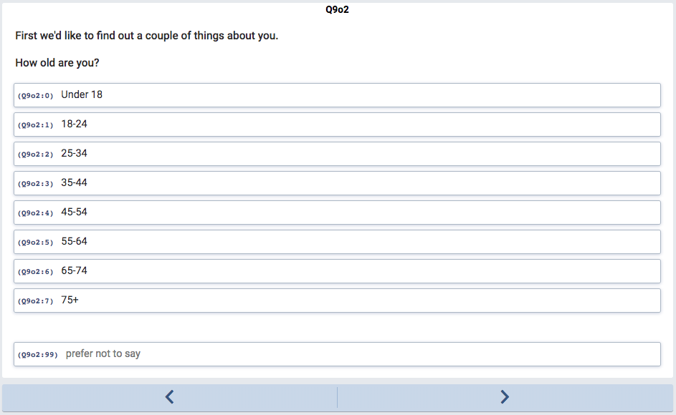

Slide 4
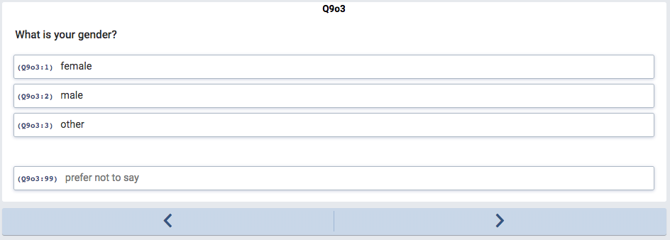

Slide 5
mainstream activity label = T0
if respondents answer “no”, they skip the next 3 questions

Slide 6
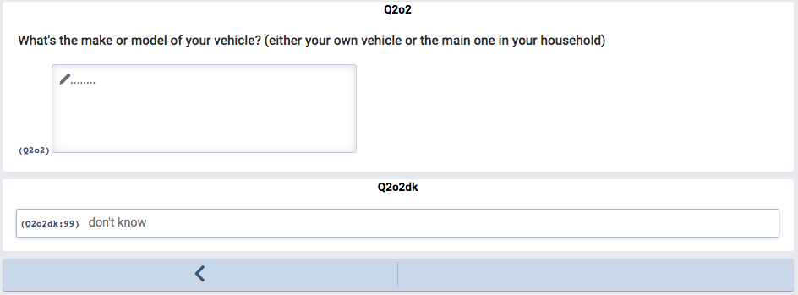
this question is asked in the past tense if respondents answer “yes, in the past but not now” to the previous question
same applies to the next 2 questions

Slide 7
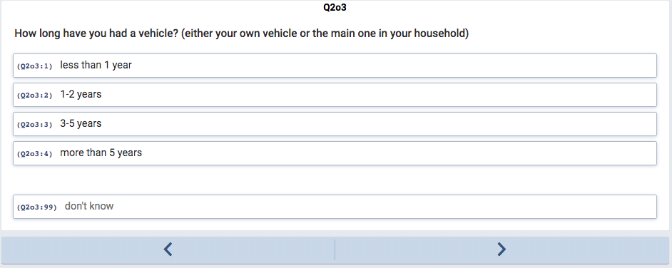

Slide 8
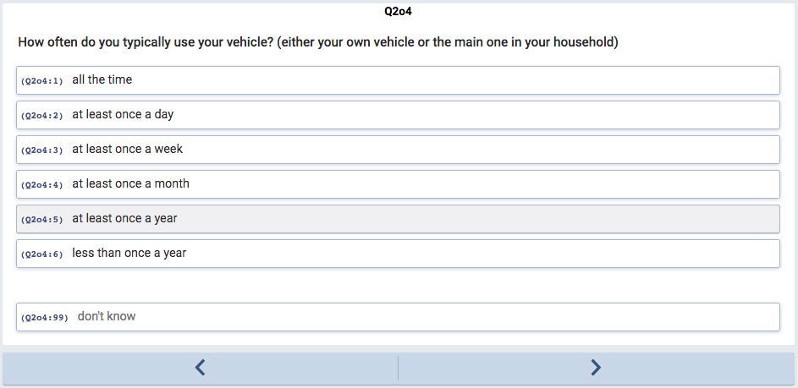

Slide 10
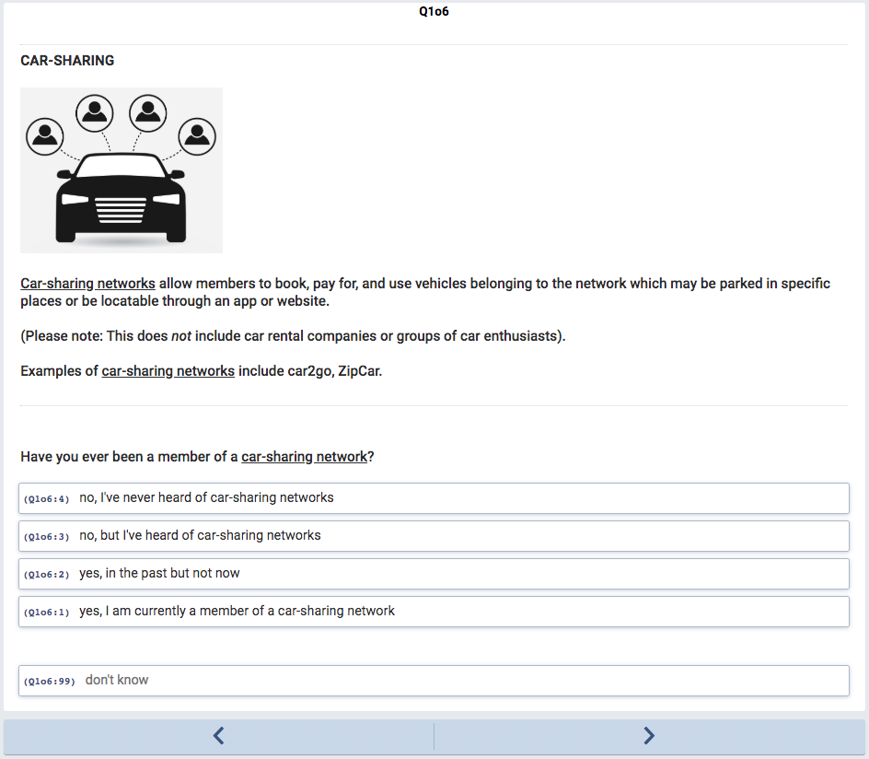
innovation label = T1
if respondents answer “no”, they skip the next 3 questions

Slide 11
this question is asked in the past tense if respondents answer “yes, in the past but not now” to the previous question
same applies to the next 2 questions

Slide 12
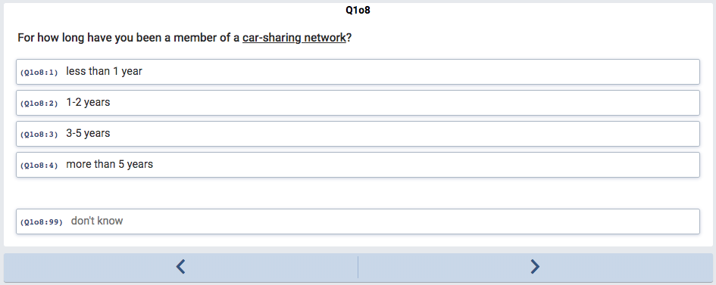

Slide 13
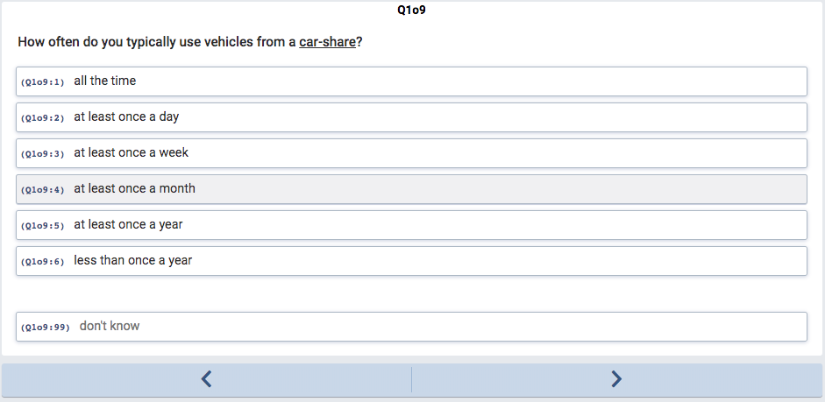

Slide 14
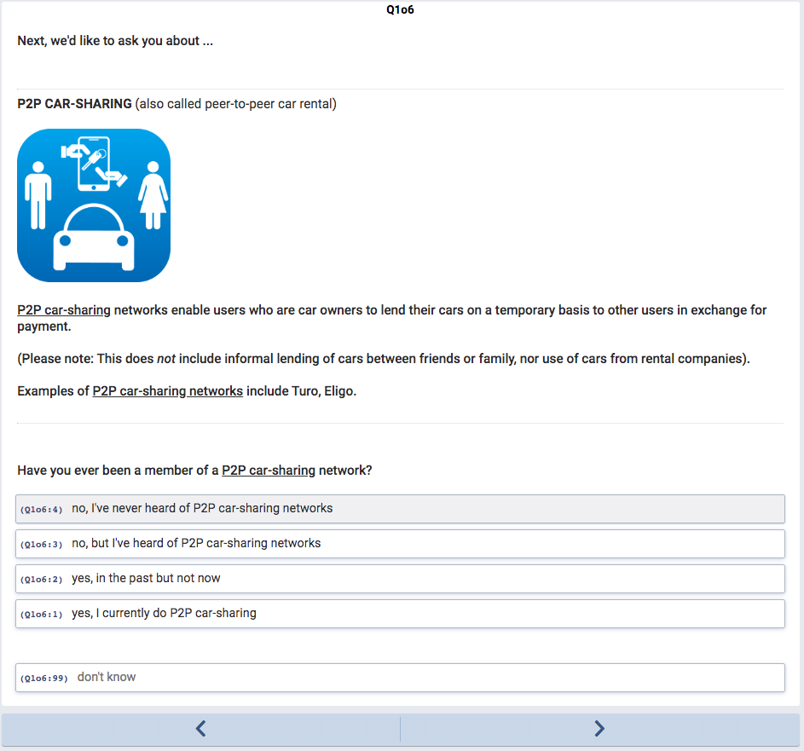
innovation label = T2
NB. the next 3 questions (Q1o7-Q1o9) for respondents who answer “yes” are not shown (see car-sharing example earlier)

Slide 15
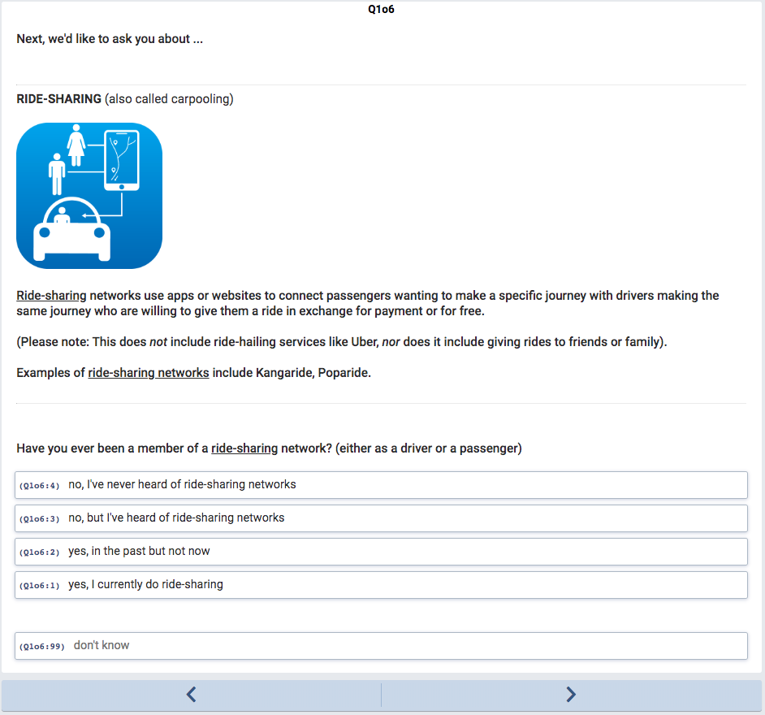
innovation label = T3
NB. the next 3 questions (Q1o7-Q1o9) for respondents who answer “yes” are not shown (see car-sharing example earlier)

Slide 16
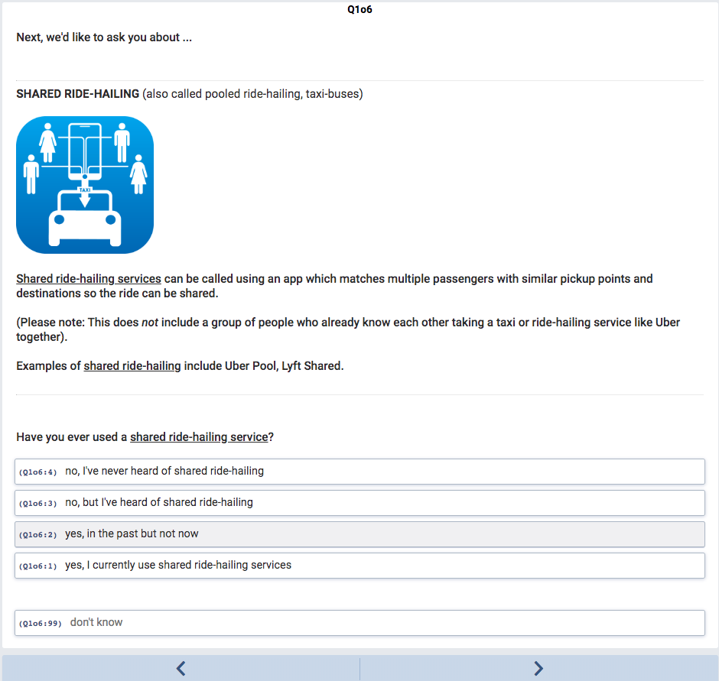
innovation label = T4
NB. the next 3 questions (Q1o7-Q1o9) for respondents who answer “yes” are not shown (see car-sharing example earlier)

Slide 17
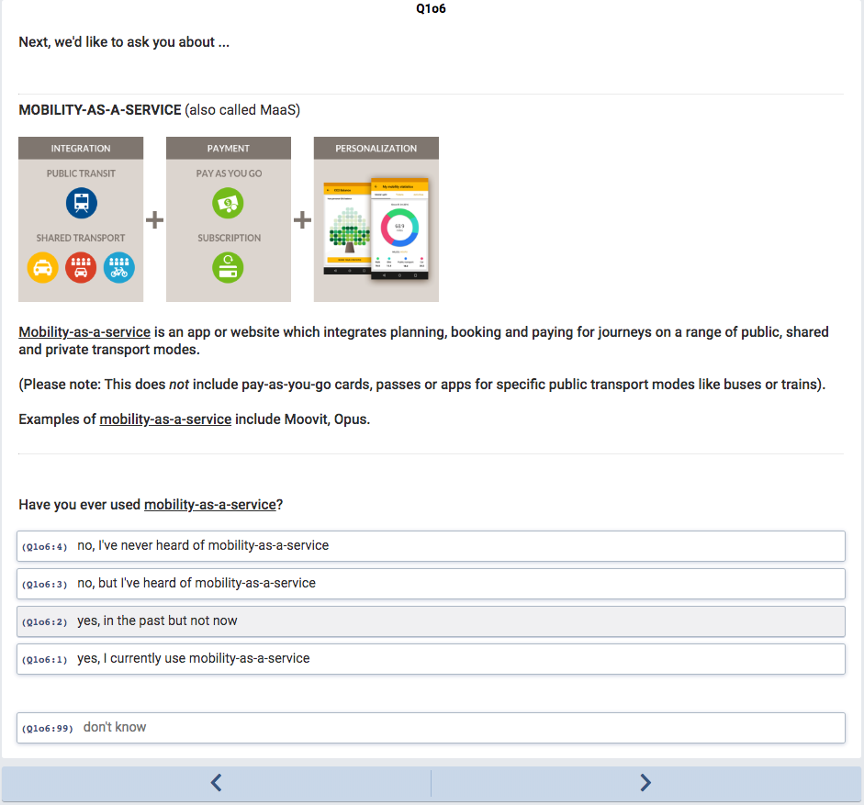
innovation label = T5
NB. the next 3 questions (Q1o7-Q1o9) for respondents who answer “yes” are not shown (see car-sharing example earlier)

Slide 18
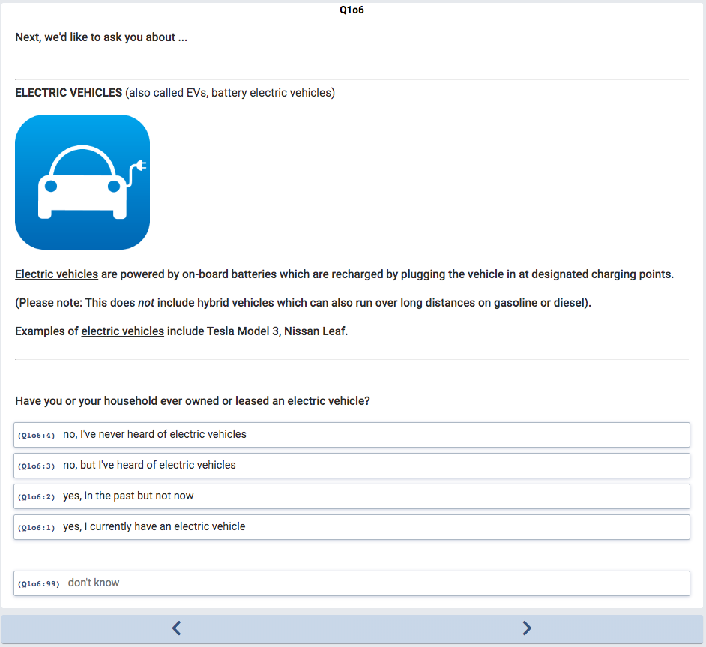
innovation label = T6
NB. the next 3 questions (Q1o7-Q1o9) for respondents who answer “yes” are not shown (see car-sharing example earlier)

Slide 19
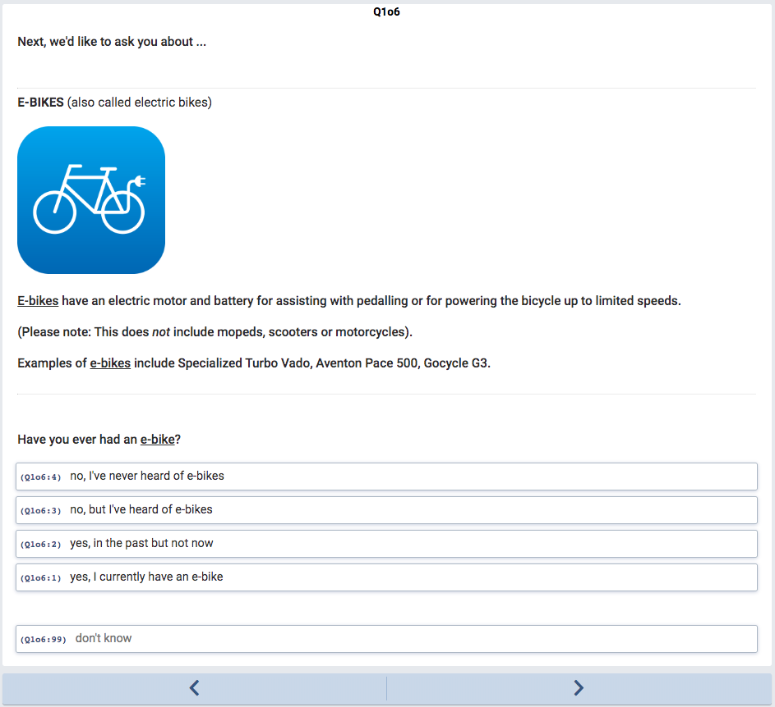
innovation label = T7
NB. the next 3 questions (Q1o7-Q1o9) for respondents who answer “yes” are not shown (see car-sharing example earlier)

Slide 20
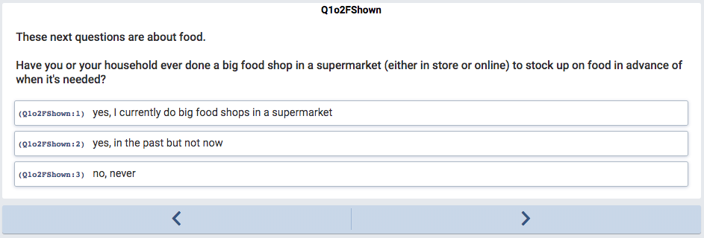
mainstream activity label = F0
NB. the next 3 questions (Q2o2-Q2o4) for respondents who answer “yes” are not shown (see ‘having a vehicle’ example earlier)

Slide 22
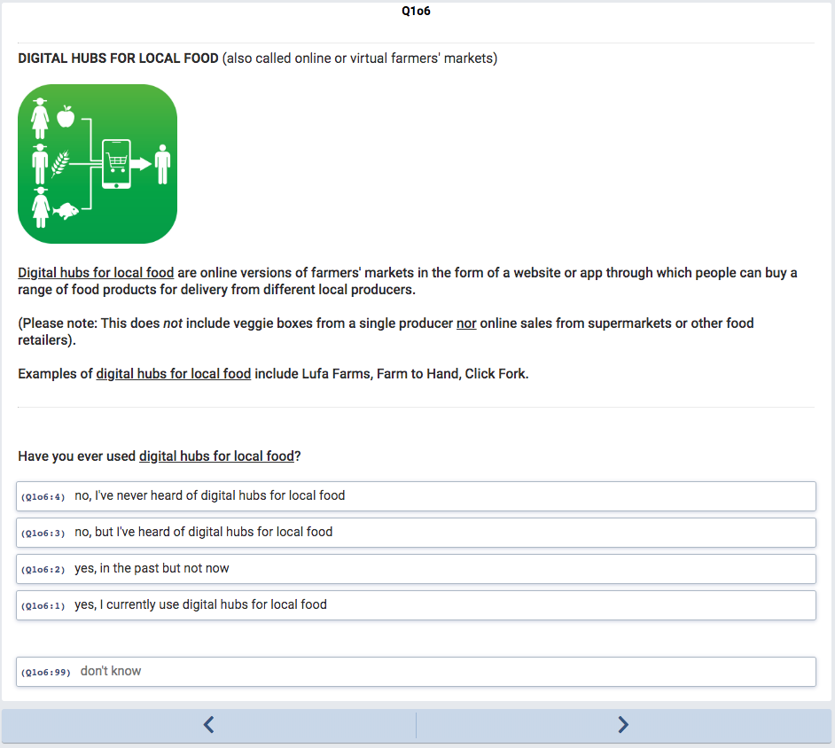
innovation label = F1
NB. the next 3 questions (Q1o7-Q1o9) for respondents who answer “yes” are not shown (see car-sharing example earlier)

Slide 23
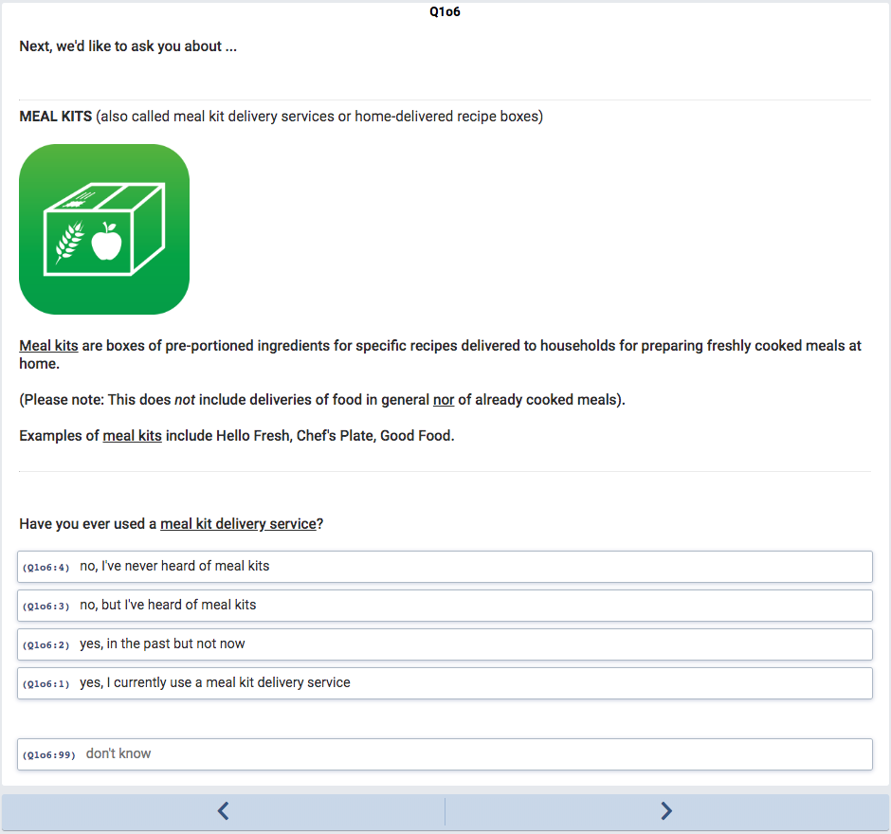
innovation label = F2
NB. the next 3 questions (Q1o7-Q1o9) for respondents who answer “yes” are not shown (see car-sharing example earlier)

Slide 24
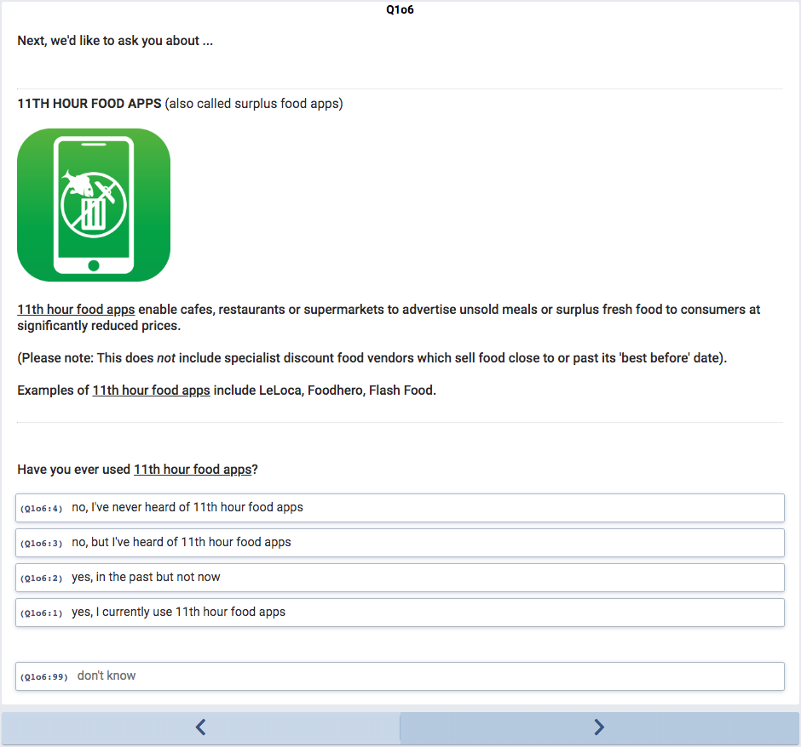
innovation label = F3
NB. the next 3 questions (Q1o7-Q1o9) for respondents who answer “yes” are not shown (see car-sharing example earlier)

Slide 25
no questions are asked for mainstream activity label = H0

Slide 26
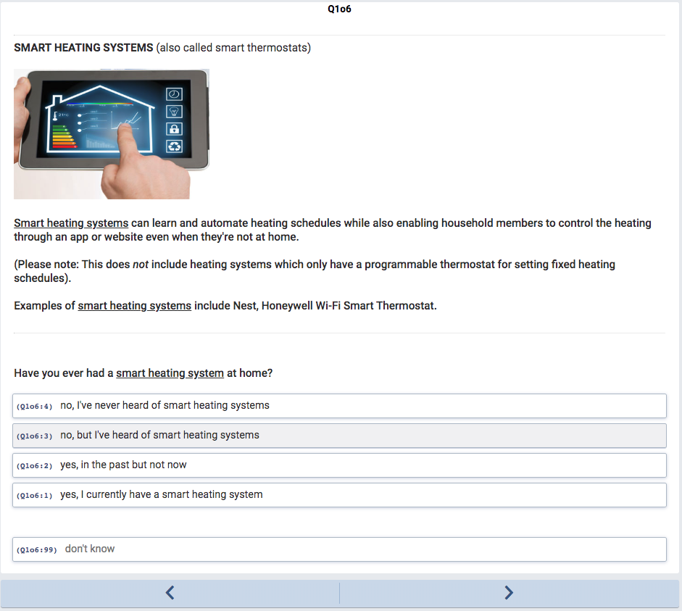
innovation label = H1
NB. the next 3 questions (Q1o7-Q1o9) for respondents who answer “yes” are not shown (see car-sharing example earlier)

Slide 27
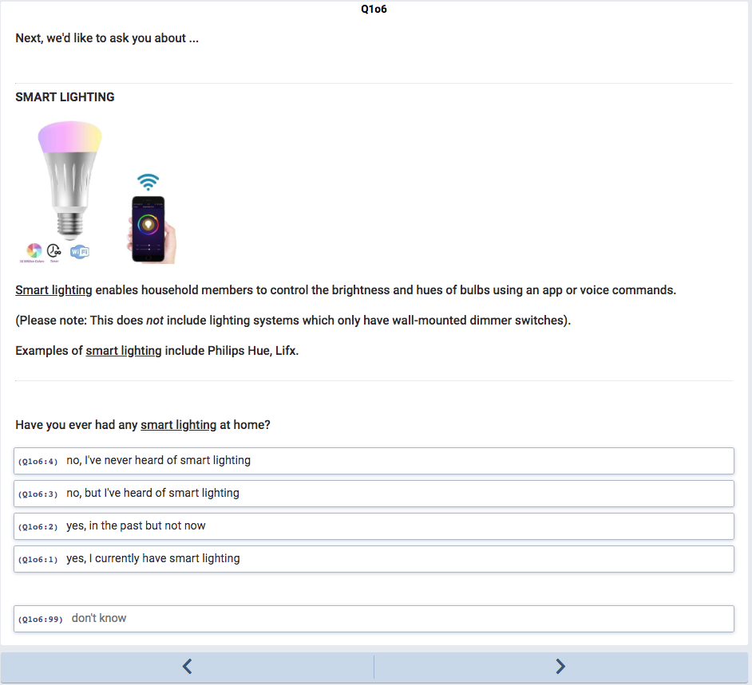
innovation label = H2
NB. the next 3 questions (Q1o7-Q1o9) for respondents who answer “yes” are not shown (see car-sharing example earlier)

Slide 28
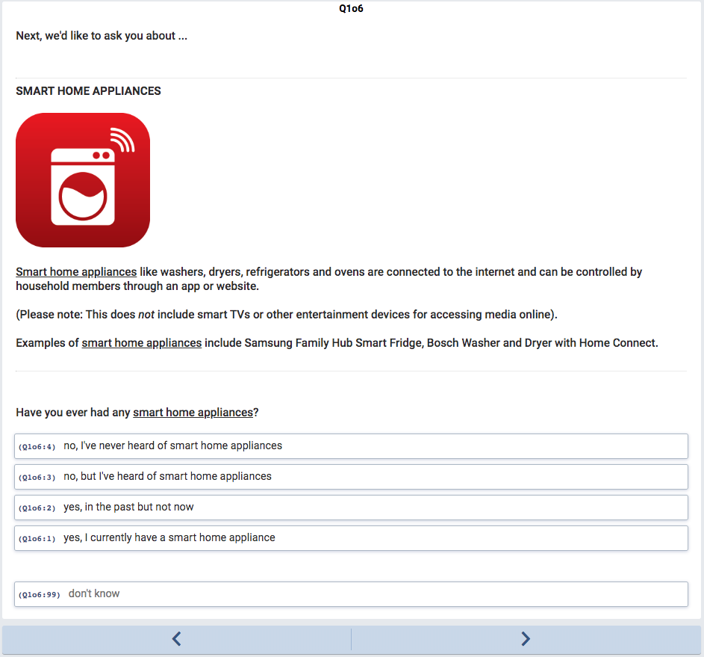
innovation label = H3
NB. the next 3 questions (Q1o7-Q1o9) for respondents who answer “yes” are not shown (see car-sharing example earlier)

Slide 29
mainstream activity label = E0
NB. the next 3 questions (Q2o2-Q2o4) for respondents who answer “yes” are not shown (see ‘having a vehicle’ example earlier)

Slide 31
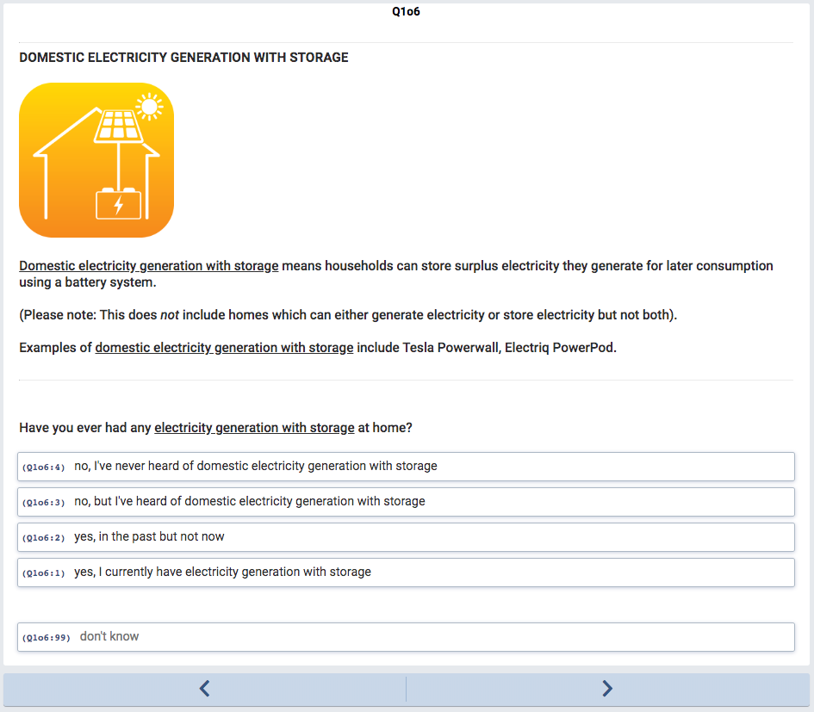
innovation label = E1
NB. the next 3 questions (Q1o7-Q1o9) for respondents who answer “yes” are not shown (see car-sharing example earlier)

Slide 32
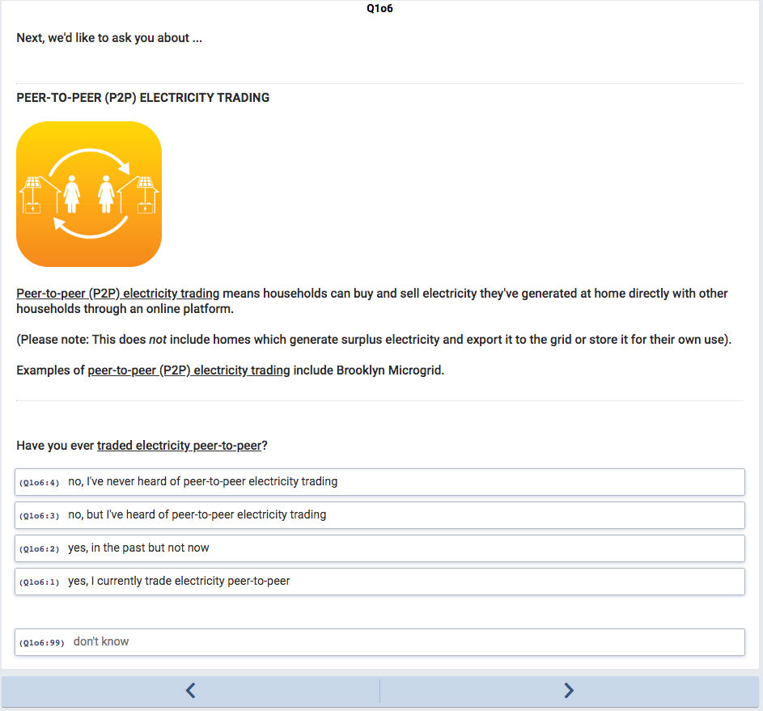
innovation label = E2
NB. the next 3 questions (Q1o7-Q1o9) for respondents who answer “yes” are not shown (see car-sharing example earlier)

Slide 33
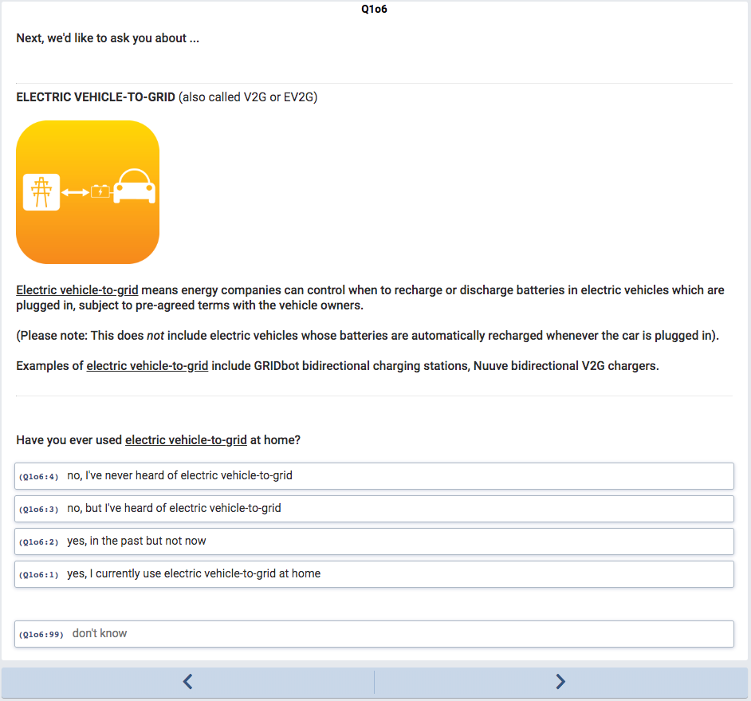
innovation label = E3
NB. the next 3 questions (Q1o7-Q1o9) for respondents who answer “yes” are not shown (see car-sharing example earlier)

Slide 34
That’s the end of the introductory questions which establish whether respondents use or have heard of
16 different innovations and 4 mainstream activities in each of 4 domains: transport, food, homes, energy.

Slide 35
Allocation algorithm (or prioritisation algorithm)
Having answered these questions, respondents are classified for each of the 16 innovations (T1-T7, F1-F3, H1-H3, E1-E3) and 3 mainstream activities (T0, F0, E0) as:
adopter = yes, I use this … either currently or in the past
non-adopter = no, I don’t use this ... but I have heard of it
not classified = no … I have never heard of this
All respondents are classified as adopters for the 4th mainstream activity (H0) as this is = manually controlling devices at home (which everyone does!).
So, as an example, at this point in the survey one respondent might be classified as:
Based on this classification, an ‘allocation algorithm’ decides which survey variant to allocate the respondent to. The algorithm first prioritises adopters of innovations, then non-adopters of innovations, then adopters of mainstream activities (subject to quotas in each case).
In this example, the respondent is allocated to survey variant T1 as an adopter.
(T1 is the ‘car-sharing’ innovation).

Slide 36
The wording of these next blocks of questions is varied and adapted to each innovation or mainstream activity.
This gives 20 survey variants: 16 innovations + 4 mainstream activities.
Both adopters and non-adopters can be allocated to each survey variant.
Some questions are worded slightly differently for adopters and non-adopters (e.g., present vs. future tense).
The following questions are shown for adopters of one particular survey variant (T1 = car-sharing).

Slide 37
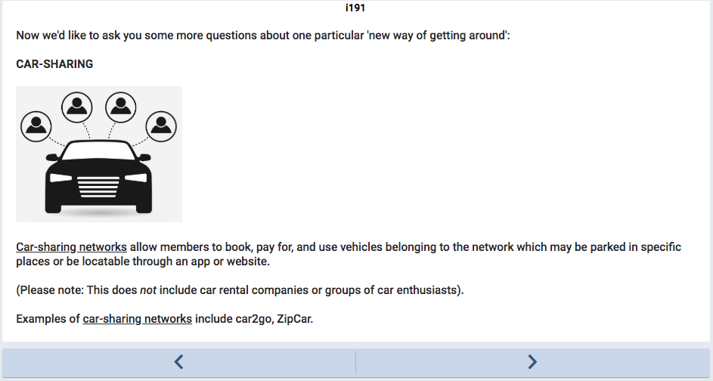

Slide 38
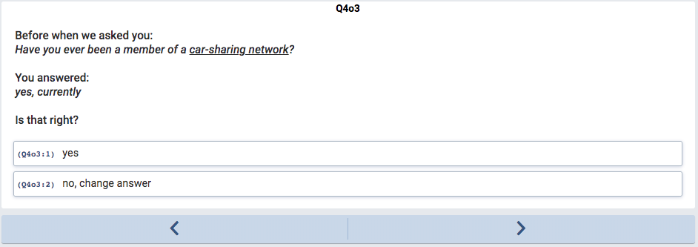

Slide 39
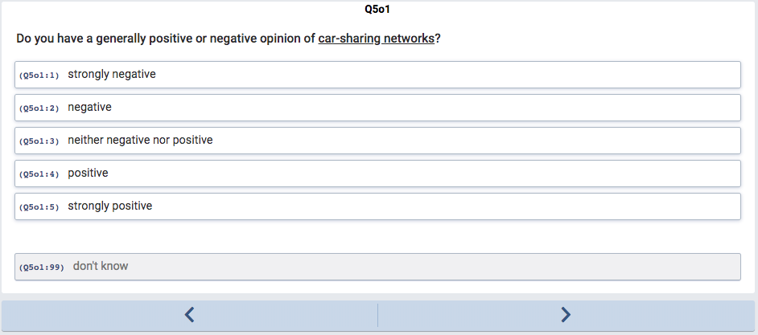

Slide 40
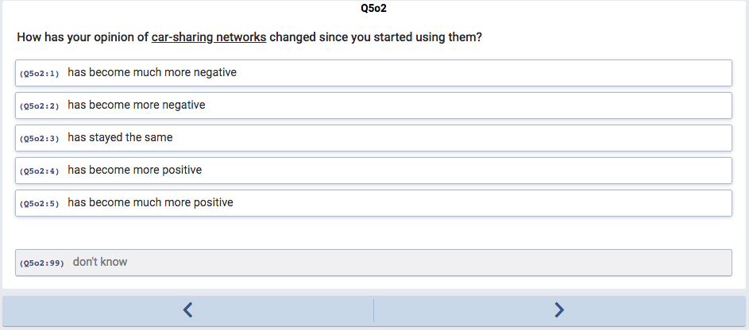

Slide 41
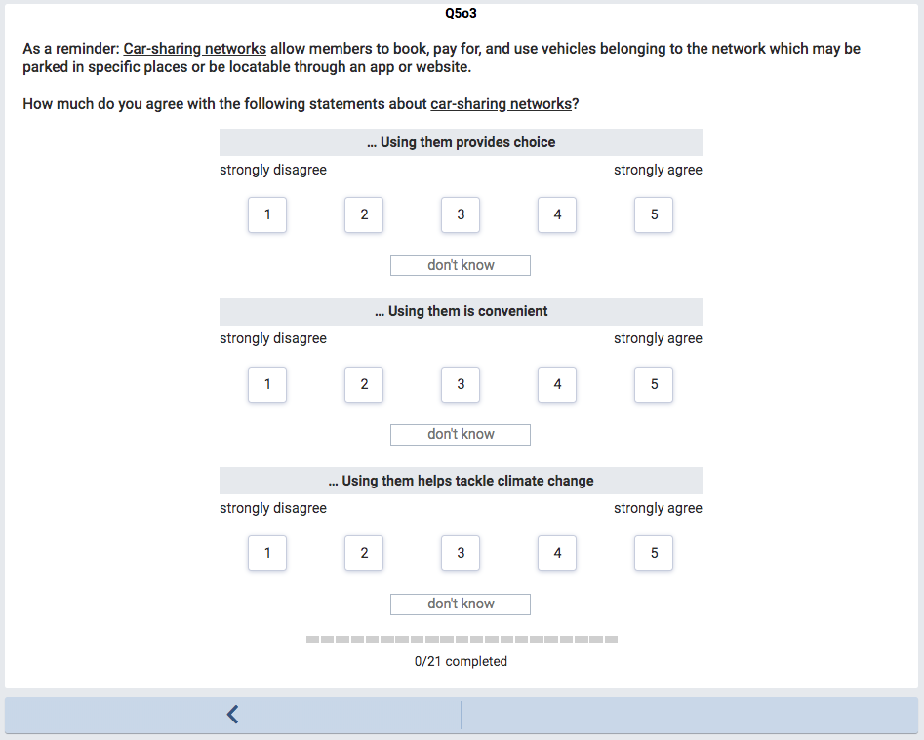

Slide 42
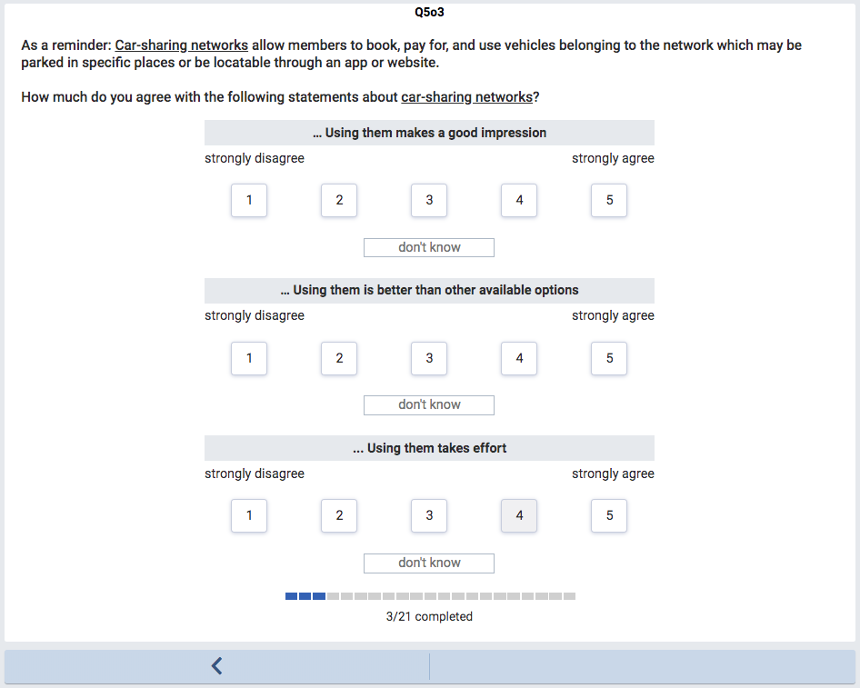

Slide 43
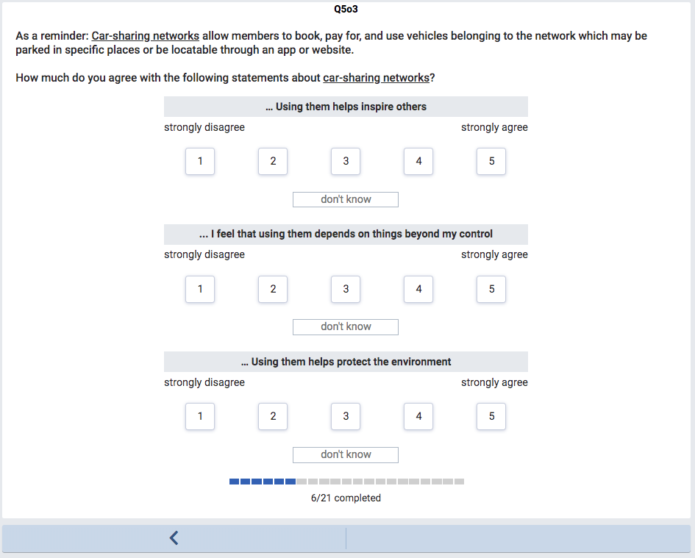

Slide 44
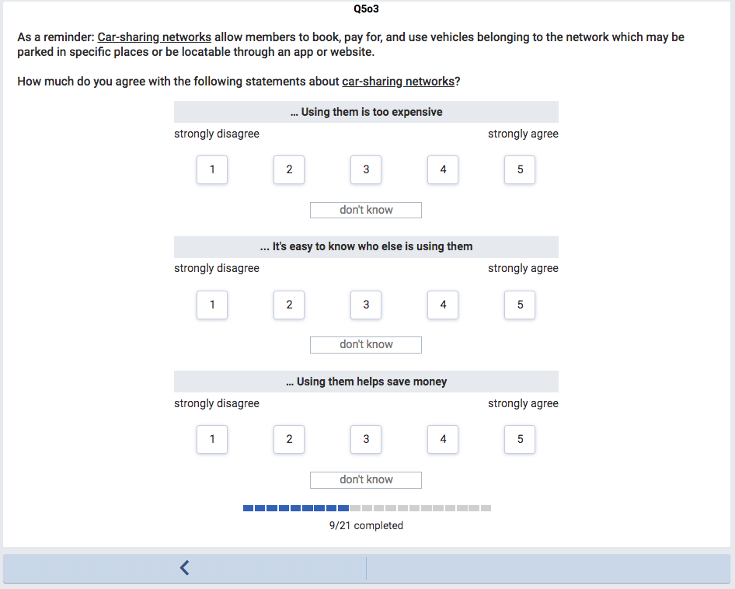

Slide 45
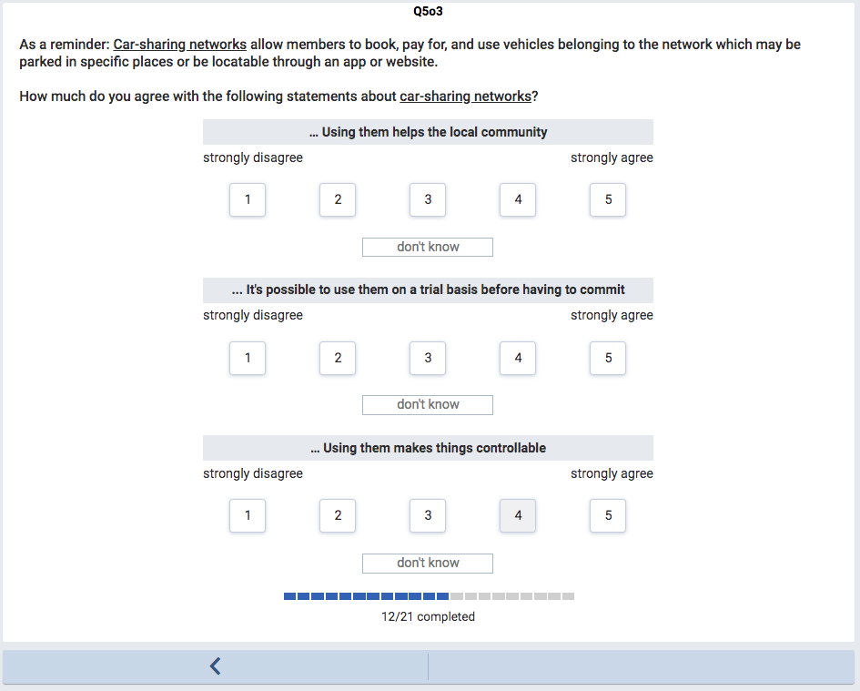

Slide 46
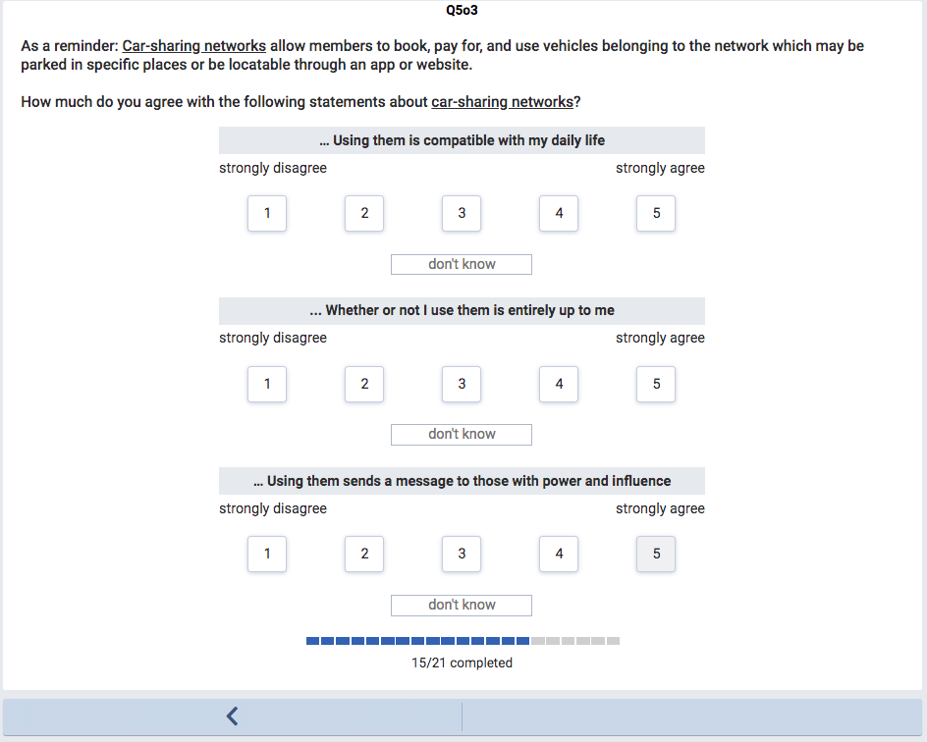

Slide 47
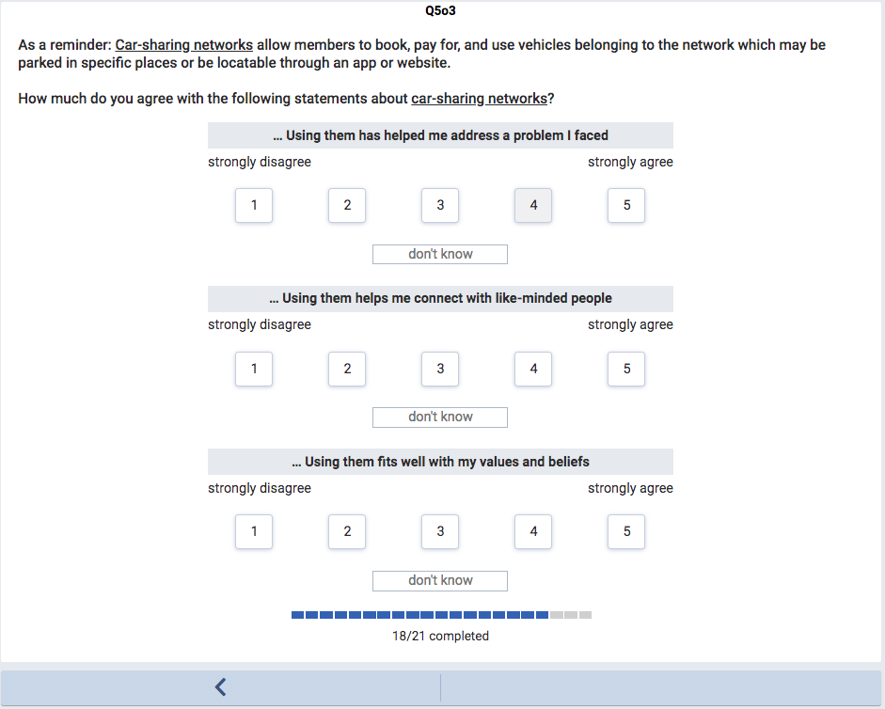

Slide 50
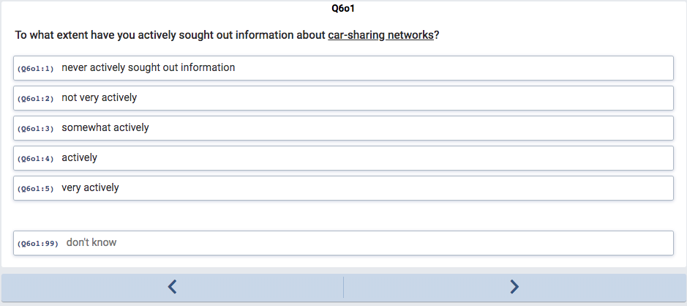

Slide 51
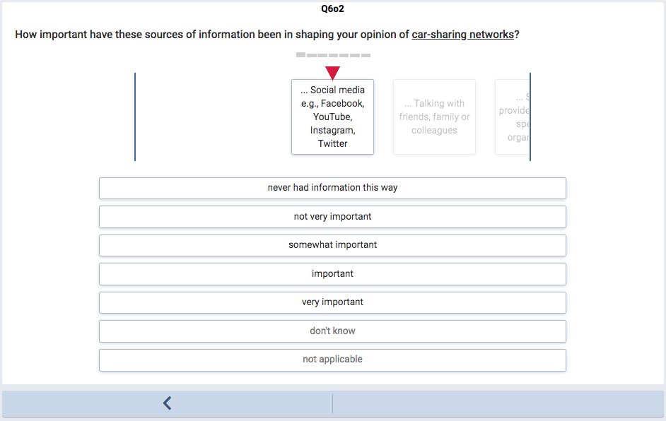

Slide 52
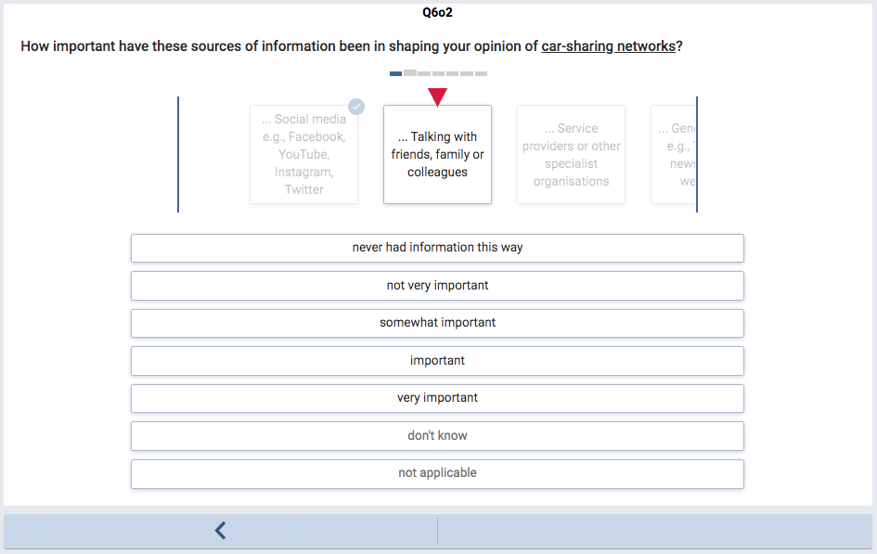

Slide 53
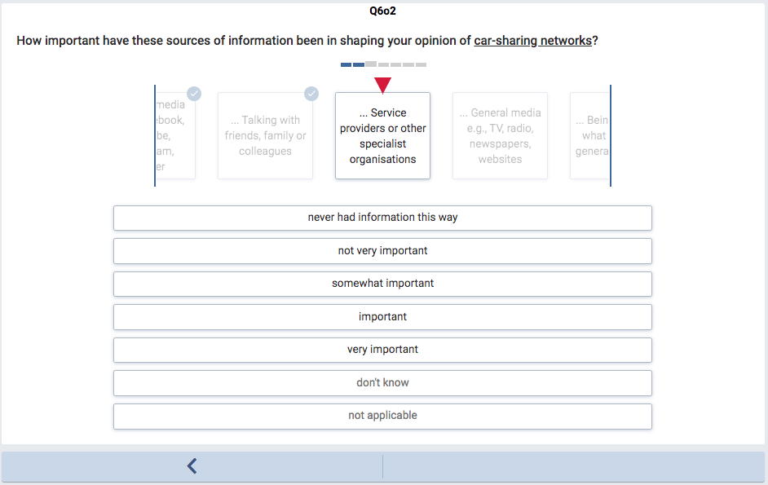

Slide 54
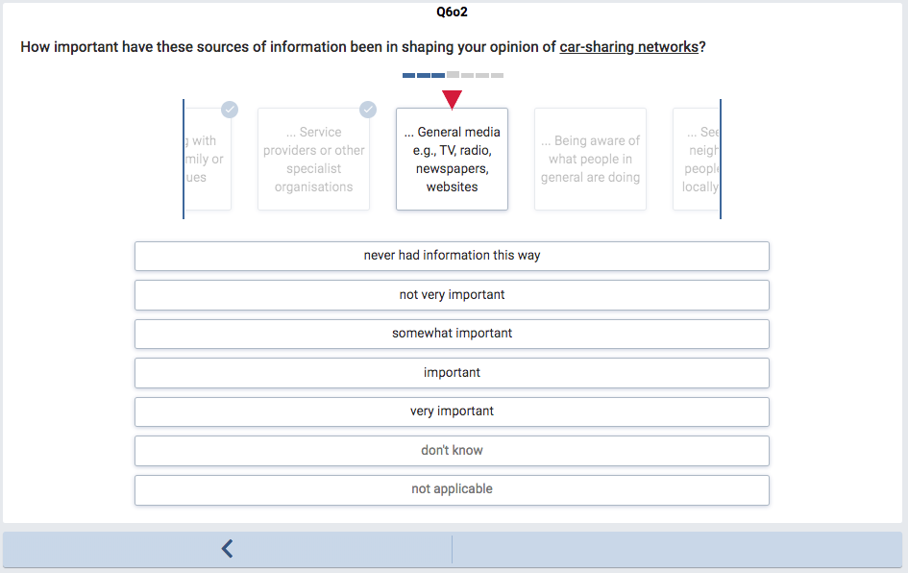

Slide 55
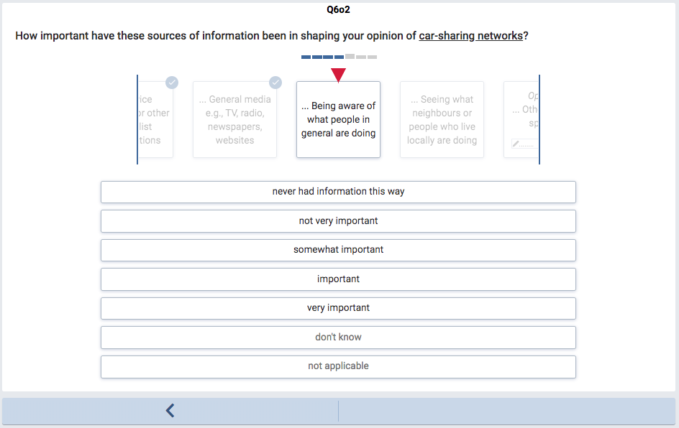

Slide 56
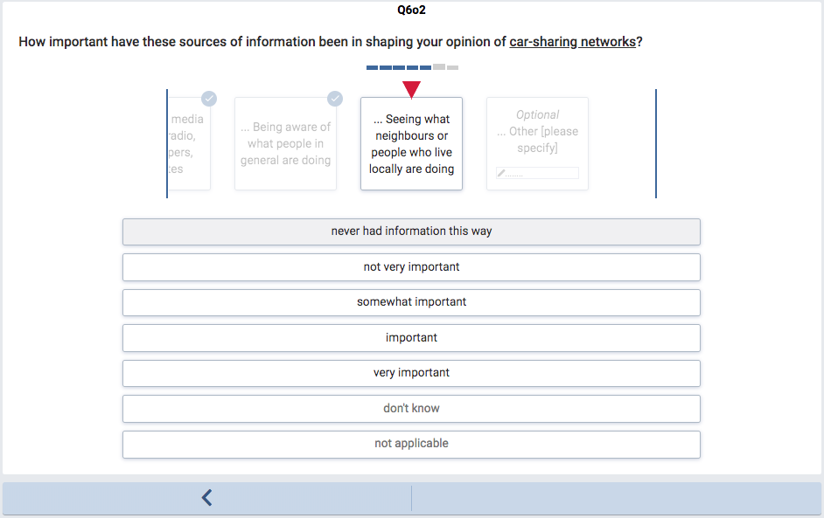

Slide 57
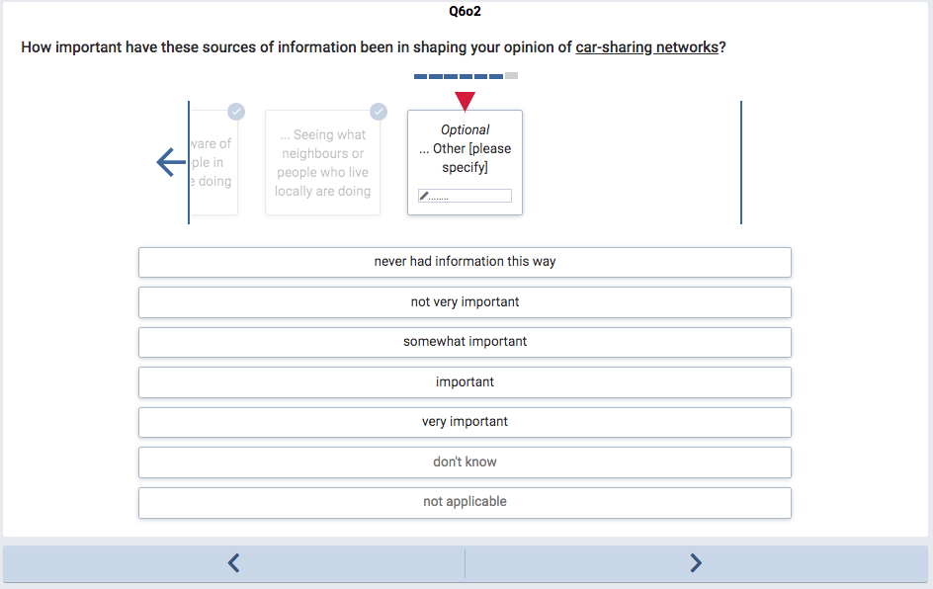

Slide 58
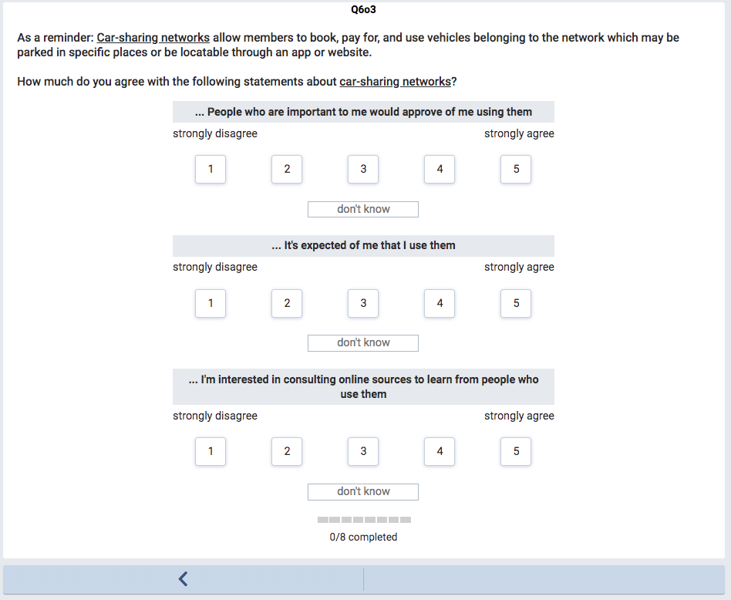

Slide 59
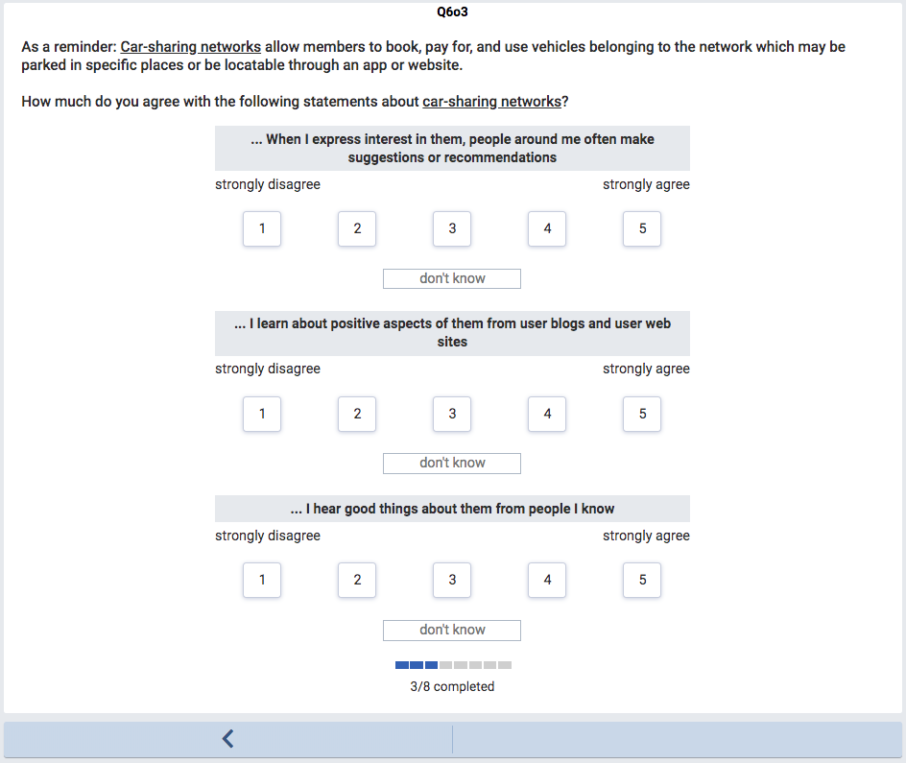

Slide 60
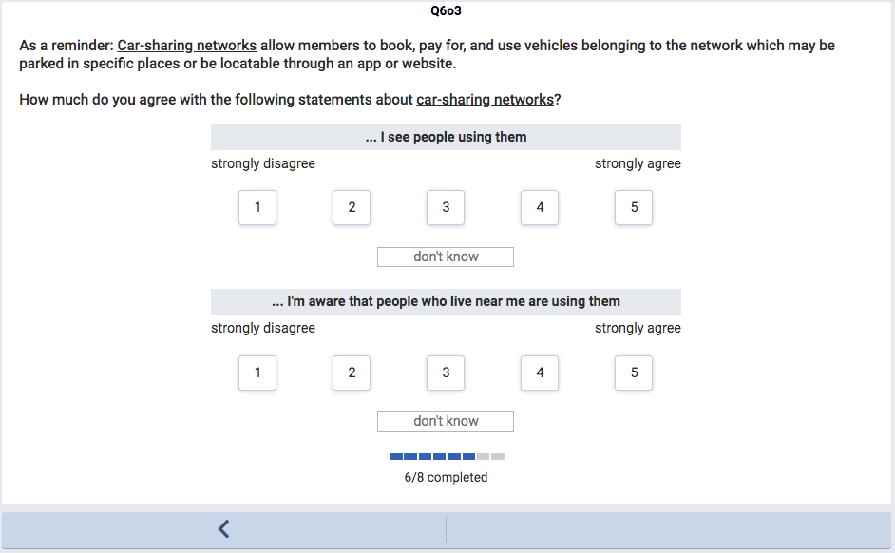

Slide 61
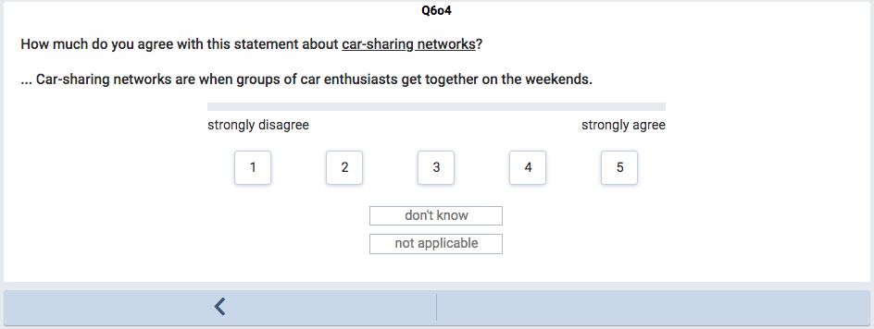

Slide 62
That’s the end of the questions specific to one innovation or mainstream activity.
The questions shown were for T1 = car-sharing. See spreadsheet for questions for all other innovations and mainstream activities.
These next blocks of questions are varied and adapted to one of four domains: transport, food, homes, energy.
The domain is consistent with the innovation or mainstream activity from the previous blocks of questions.
The following questions are for one particular domain (T = transport).

Slide 63
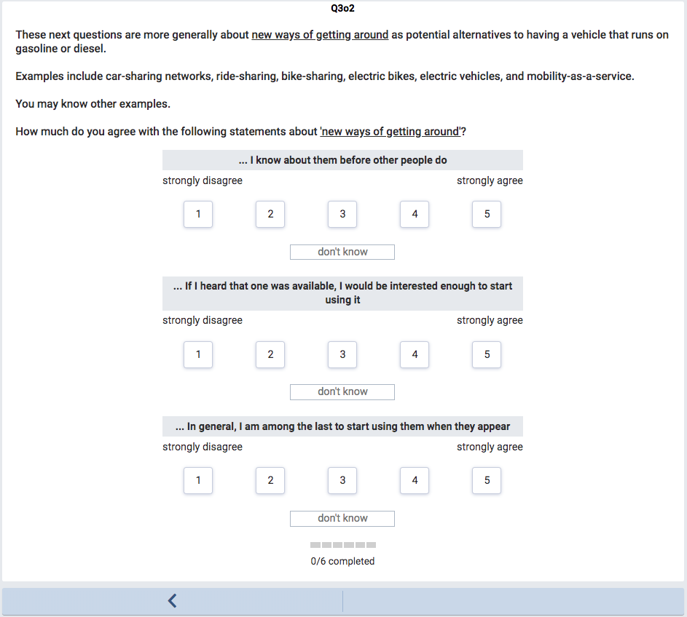

Slide 64
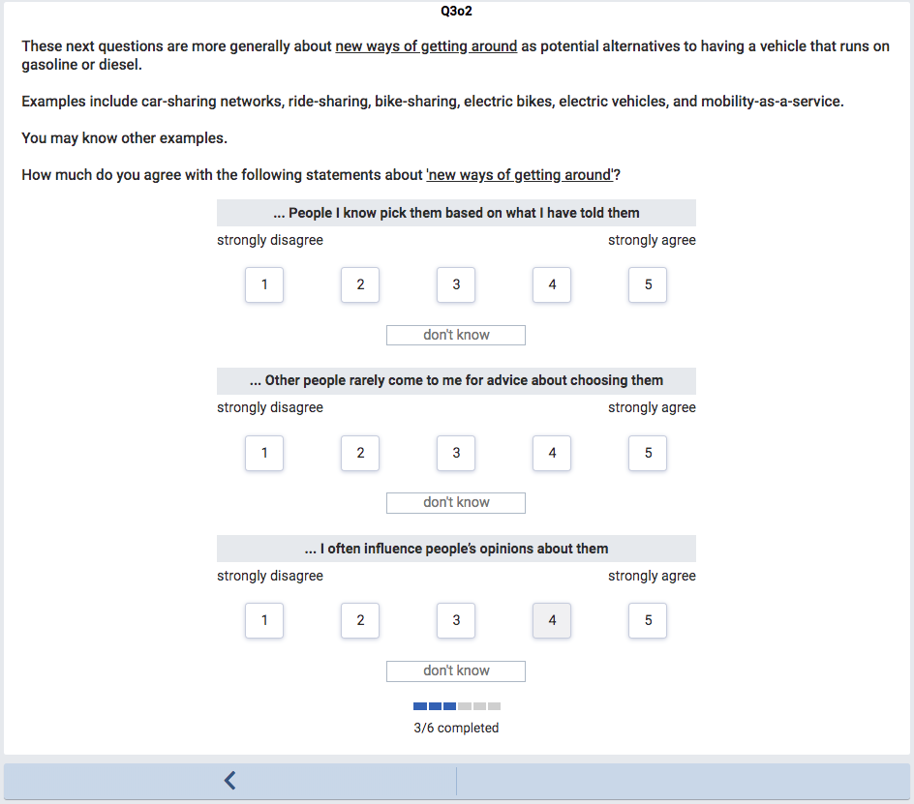

Slide 66
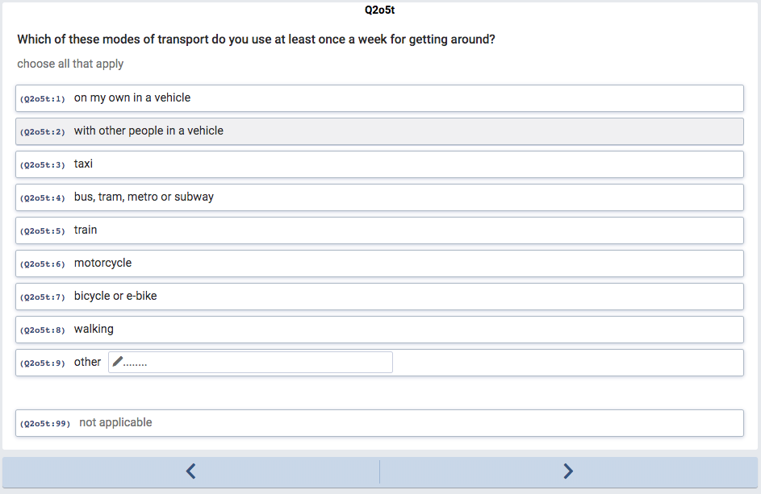

Slide 71
These final blocks of questions are the same for all respondents.

